Slide 1
Probability & Random Processes EE2011 Department of Electrical Engineering
NATIONAL UNIVERSITY OF COMPUTER & EMERGING SCIENCES, LAHORE CAMPUS

Slide 2





Slide 3

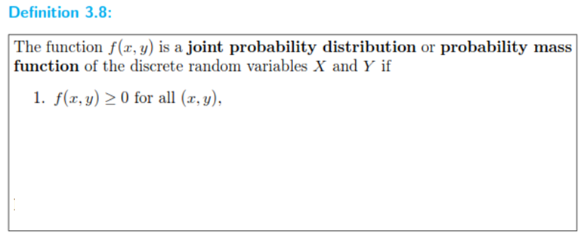



Slide 4


Slide 5




Slide 7
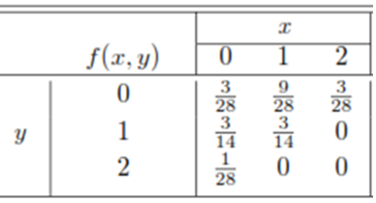


Slide 8





Slide 9




Slide 10


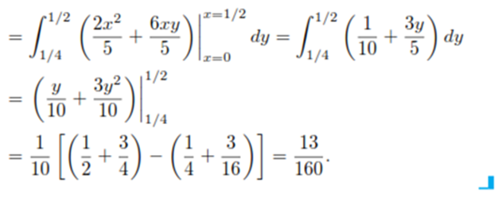

Slide 11


Slide 12
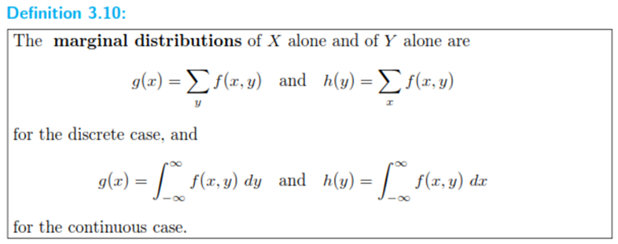


Slide 13







Slide 14
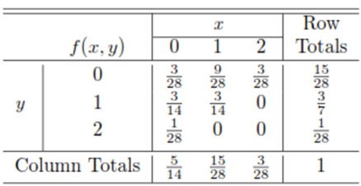
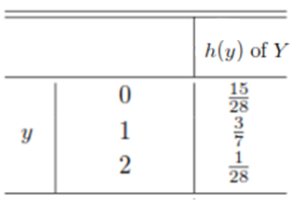
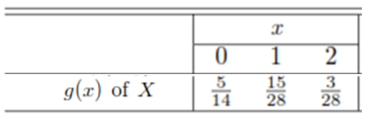

Slide 15



Slide 16

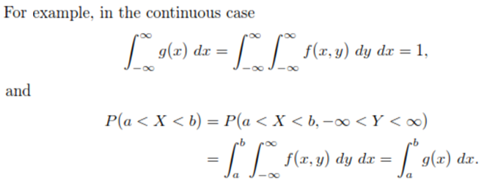

Slide 17


Slide 18




Slide 19
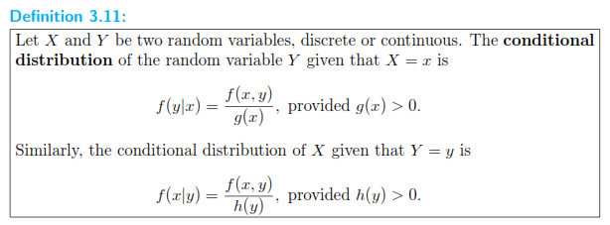

Slide 20



Slide 21





Slide 22






Slide 23

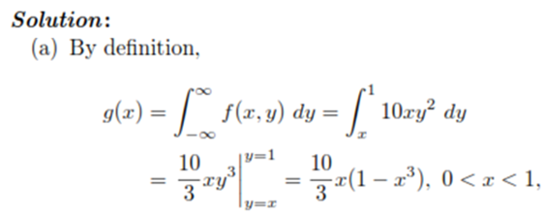

Slide 24



Slide 25




Slide 26



Slide 27





Slide 28


Slide 29






Slide 30



Slide 31






Slide 32




Slide 33



Slide 34


Slide 35





